Slide 1
JavaScript Interoperability (JS Interop)

Slide 2
Introduction to JS Interop
Calling JavaScript functions from Blazor and vice versa

Slide 3
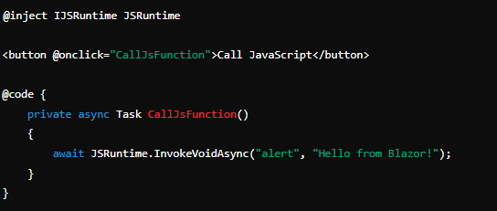
Calling JavaScript from Blazor
Using IJSRuntime

Slide 4
Calling blazor fun from js
Learn how to invoke Blazor methods from JavaScript. This allows JavaScript code to call methods defined in your Blazor components or services.
HINTS :
Register the .NET method that can be called from JavaScript
JSRuntime.InvokeVoidAsync("registerDotNetObject", DotNetObjectReference.Create(this));
[JSInvokable]

